Slide 1



STOCK MARKET INVESTORS:
Top 100 Most Viewed Stocks
Group 4 Members: Hikmet, Tyler, Ana, Abish

Slide 2

Table Of Contents
01
02
03
Data Collection
Database
API
04
05
06
Javascript
Market Analysis
Conclusion
Highlight how the data was collected
Indicate where the data was stored in a database
Refer to how the data would be sourced and incorporated
Reference to libraries and applications utilized
Comparative Analysis for the most viewed stocks
Final Analysis on Ideal stock Choice

Slide 3



01.
Data Collection
Process Incorporated

Slide 4

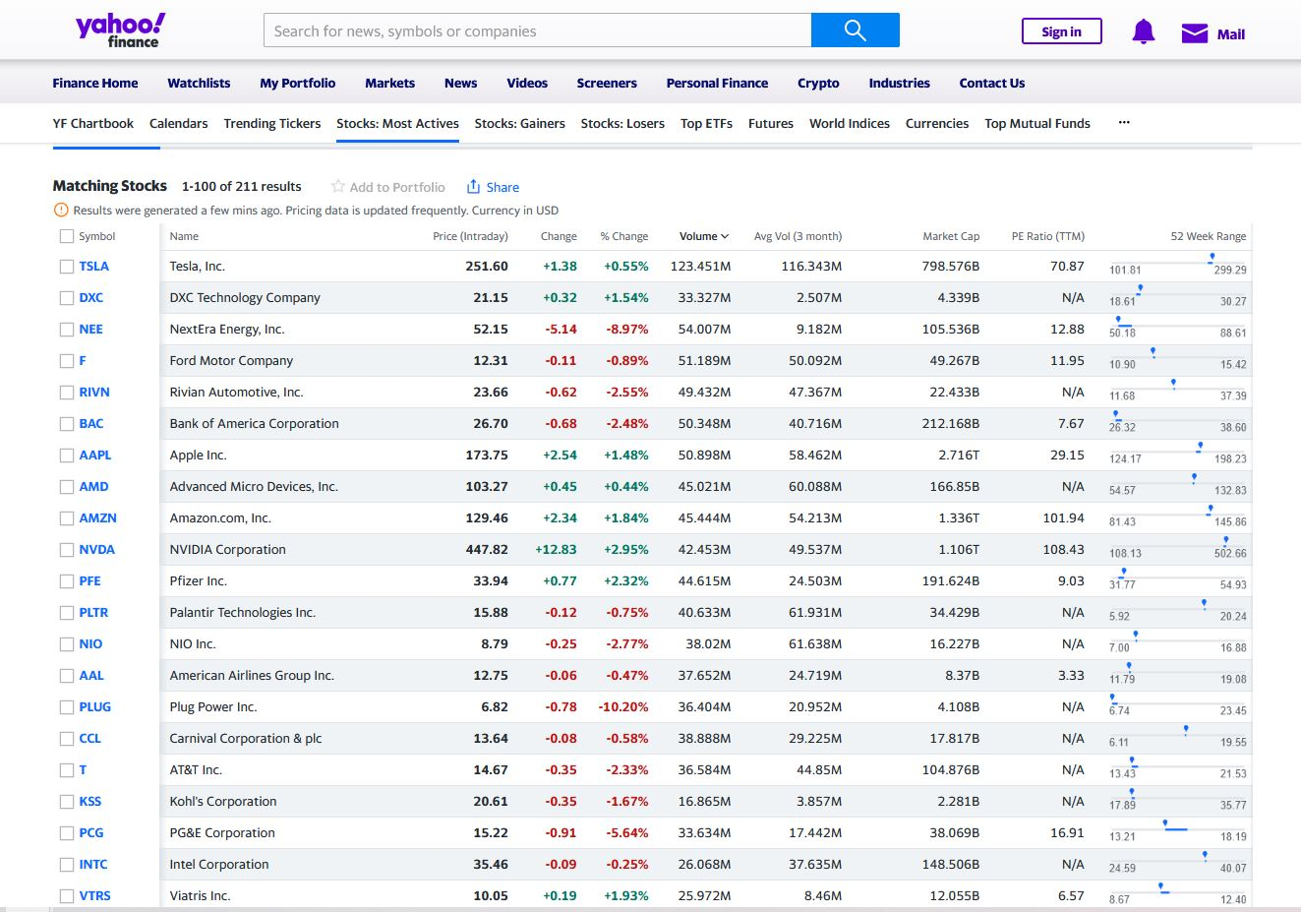

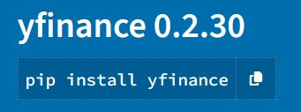
Data Collection
The data was collected from the following url:
https://finance.yahoo.com/most-active/?count=100&offset=0
- Choose the 100 most active stocks that are traded daily, and actively tracked using the Yahoo Finance Platform.
- Able to extract the source data, using the below
Python Package.

Slide 5

02.
Database
Data Storage and Retrieval

Slide 6


XML
We stored the data in an XML format:
- Considered to be a NoSQL database as per website documentation.
- Used the XML – Enabled Database:
Data was stored in tables consisting of rows and columns. The main tables contained a set of records, which in turn consisted of fields which were then used to extract Data in the form of an API for further analysis

Slide 7
03.
API
Information Access & Utilization

Slide 8


API Analysis
Flask
JSON
Index
Created a sample API to access the data from JSON
Converted CSV data into JSON format
Defined a specific route to retrieve data for a specific index

Slide 9
04.
Javascript
Code Analysis & Libraries Utilized

Slide 10

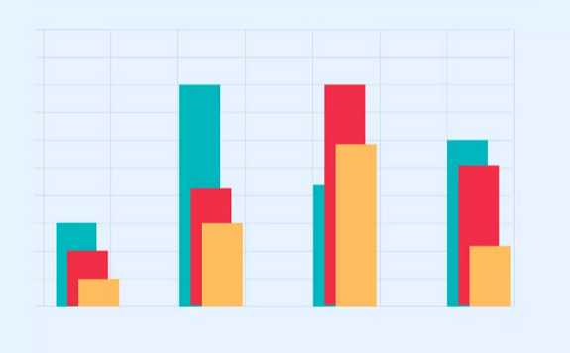
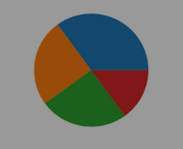

Libraries & Visualizations Used
Chart.js
Column Chart
Line Graph
Pie Chart
Utilized Chart.js library to showcase data in javascript
Created a Column Chart to indicate the Top 5 most viewed stocks from a total volume perspective
Daily Stock movement of the 100 most viewed stocks running from September 2022 to 2023, based on closing price.
Created a Pie Chart to indicate the Top 5 most viewed stocks from a dividend perspective

Slide 11
05.
Market Analysis
Decision Criteria for Picking a Particular stock

Slide 12





Tesla
Apple
AMD
Amazon
Google
Top 5 Most Valued Companies – Volume Perspective

Slide 13
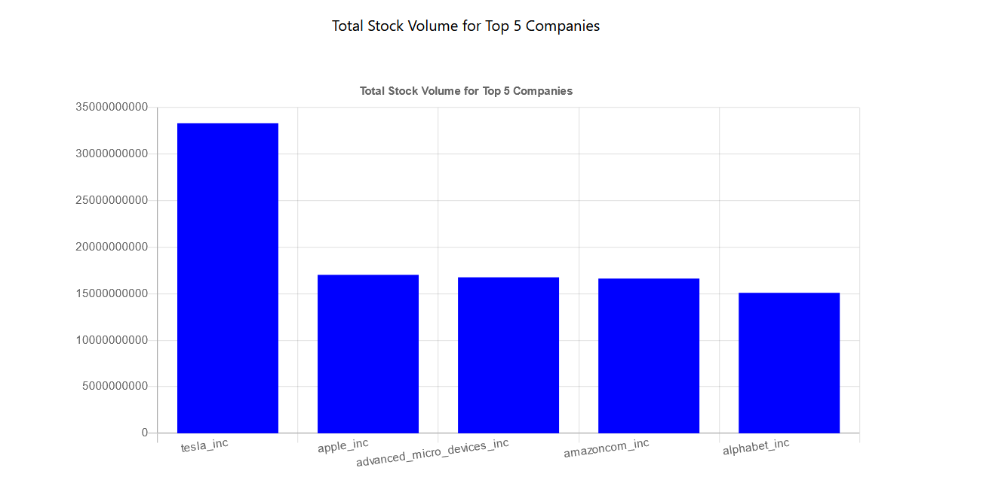

Column Chart
Total Stock Volume of Companies:
Volume can be used to confirm trend direction.
Essentially increase in volume must correlate with an increase in trend.
Volume can be used to indicate market strength, as when prices rise with increasing volume, the market trend is strong & healthy; but when prices fall on increasing volume, the market trend is weak and declining.
tesla_inc | 33,313,240,100
apple_inc | 17,029,388,100
advanced_micro_devices_inc | 16,762,837,000
amazoncom_inc | 16,627,034,900
alphabet_inc | 15,096,098,158

Slide 14
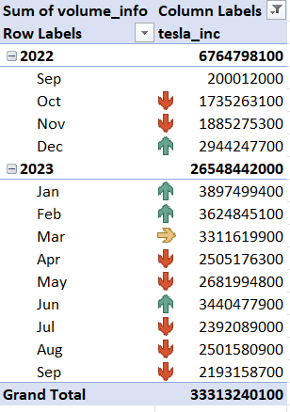
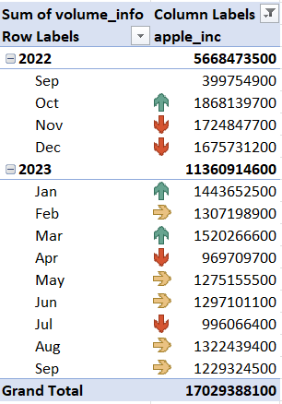
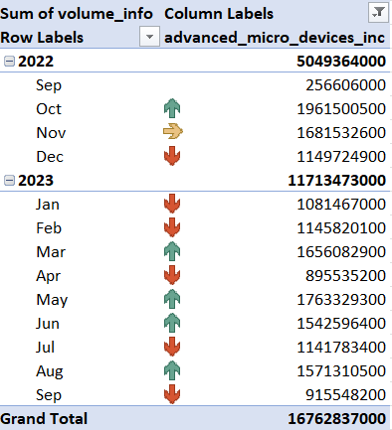
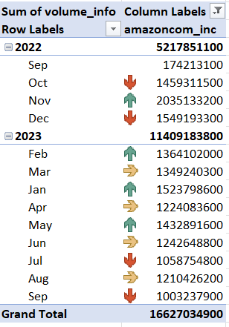

Tesla
Apple
Amazon
Google
Top 5 Most Valued Companies – Volume Perspective
AMD

Slide 15
Stock Decision Criteria
Tesla
Apple
Growth Stock (Risk Averse Investor)
Volume can be used to confirm the trend direction.
Price for this stock was at its lowest around December.
Although the volume kept increasing, the prices only started to increase in January.
Volume declined in May, but the price rebounded in June.
Although the price is steady with declining volume, a good indicator to buy back in would be when the price of the stock falls.
Blue Chip Stock (Conservative Investor)
Volume is not a good indicator of the trend, since prices hold constant.
Trading volume was the lowest in December, but the value increased in January.
Although, the trading volume decreased in April, the value of the stock stayed relatively constant in May.
However, the stock value increased in June, with trading volumes remaining fairly consistent, and this holds true till September.

Slide 16





Top 5 Most Valued Companies – Dividend Perspective
Johnson & Johnson
Petrobras
Exxon Mobil
Canadian Natural Resources
Magellan Midstream Partners

Slide 17
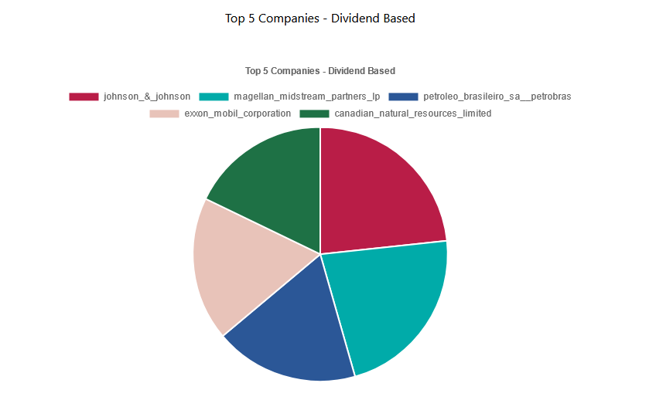
Pie Chart
Total Dividend Value of Companies:
The higher the value of a dividend, can be directly correlated to the overall financial well-being of a company.
Dividends can be paid out every quarter, semi annually or annually.
Dividends can either be paid out in Cash or they can be reinvested, to compound the overall value of an investor’s portfolio
johnson_&_johnson | 4.64
magellan_midstream_partners_lp | 4.4374
petroleo_brasileiro_sa__petrobras | 3.642
exxon_mobil_corporation | 3.64
canadian_natural_resources_limited | 3.55

Slide 18
Decision Criteria
Johnson & Johnson
Magellan Midstream Partners
Based on the distribution above:
Best to diversify the above dividend portfolio
Best to receive cash payments from Johnson & Johnson in the form dividends.
Best to reinvest dividends from Magellan Midstream Partners to compound annual growth
The medical industry might be prone the lowering dividends if interest rates rise, but the oil and gas industry is fairly consistent when it comes to honoring dividends being paid consistently.

Slide 19
06.
Conclusion

Slide 20

Final Analysis - Ideally it’s best to have a diversified portfolio. - Understanding how you would like to invest is also significant. (Risk Averse Vs.Conservative) - Deciding how dividends should be allocated, is significant when considering the nature of the market.

